Slide 1


Chapter 1
TCP
Congestion Control

Slide 2
Outline
Connection-oriented Transport: TCP
Segment Structure
Connection Management
Reliable Data Transfer

Slide 3
TCP Overview
Point-to-point
  One sender, one receiver
Reliable
  Segments delivered in-order without loss
In-order byte stream
  No message / record boundaries
Pipelined
  Sliding-window type control algorithm

Slide 4
TCP Overview
Full duplex data
  bi-directional data flow in the same connection
Connection-oriented
  handshaking (exchange of control messages) initializes sender & receiver state before data exchange

Slide 5
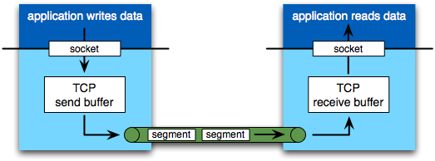
Both sides have buffers
  Lots of “Producer-Consumer” coordination problems to overcome

Slide 6
Transmission Control
Flow Control
  Sender will not overwhelm receiver
Congestion Control
  Various algorithms employed to limit sending of segments
  Don’t want to overwhelm the network

Slide 7
Outline
Connection-oriented Transport: TCP
Segment Structure
Connection Management
Reliable Data Transfer

Slide 8
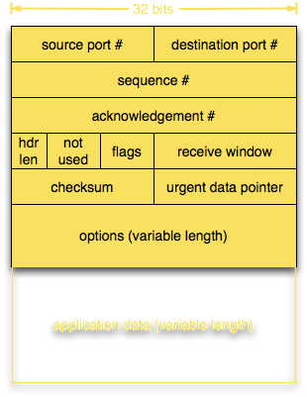
Format
Source port #: Identifies the sending application (process) on the source host.
Example: HTTP client might use port 49152.
Destination port: Identifies the receiving application on the destination host.
Example: HTTP server listens on port 80 (or 443 for HTTPS).

Slide 9
Format
Seq# and Ack#
  counted by bytes of data, not segments
Seq: number of the first byte in this segment
Ack: number of the NEXT expected byte
  Acks are cumulative
  Example: ACK = 101 means bytes up to 100 have been received correctly.

Slide 10
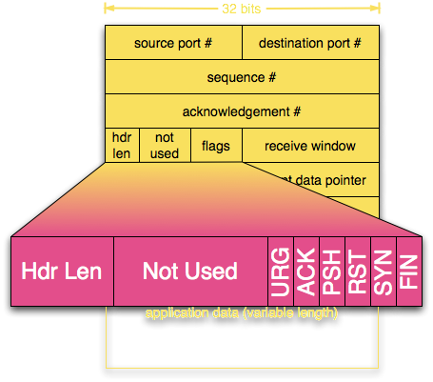

Flag Field
Header Length (4 bits)
  # words (32-bit)
  Minimum values: 5 (20 bytes)
  Can be longer with options

Slide 11
Flag Field
ACK: Segment acknowledges receipt of
another segment (i.e. ack seq# is good)
Setup and teardown signals
  SYN: Synchronize seq#
  FIN: No more data from sender
  RST: Reset connection
Rarely used
  PSH: Push the data to app-layer immediately
  URG: Urgent data, indicated by Urgent Data Pointer

Slide 12
Format
Receive window
  #bytes receiver is willing to accept
  For flow-control

Slide 13
Format
Checksum
  Error-checking for header + data.
  Ensures integrity.
Urgent data pointer
  Offset in data field
Options
  Time stamps
  Window scaling factors
  Negotiating MSS
Notes:
MSS: Maximum Segment Size

Slide 14
Format
Application Data
  Size limited by MSS
MSS=Maximum Segment Size
  Despite name, MSS is most app data that can be carried
MTU (Max Trans Unit) of lower level generally drives MSS
  App data + TCP header + IP overhead must fit in MTU
  MSS is often 1460, 536 or 512 bytes
Notes:
There are Path MTU discovery protocols (RFC 1191)

Slide 15
Question
Huge file of L bytes, MSS of 1200 bytes, TCP sequence number field of 4 bytes
What is the maximum value of L such that TCP sequence numbers are not reused?

Slide 16
Question
Huge file of L bytes, MSS of 1200 bytes, TCP sequence number field of 4 bytes
What is the maximum value of L such that TCP sequence numbers are not reused?
Kind of a trick question…
TCP sequence number is based on number of bytes, not segments ➙ MSS is irrelevant
Sequence number field is 32-bits, but all sequence number arithmetic is modulo 2³² so a theoretical file of L = ∞ bytes is possible

Slide 17
Outline
Connection-oriented Transport: TCP
Segment Structure
Connection Management
Reliable Data Transfer

Slide 18
TCP Connection Management
Why connection establishment?
  TCP sender, receiver setup state before exchanging data segments
  Initialize TCP variables:
    seq#s
    buffers, flow control info (RcvWindow)
Why requiring connection teardown?
  Free up state – remove connection info from memory (control blocks, buffers, sequence tracking).
  Release resources – so ports, memory, and buffers can be reused for new connections.
  Ensure reliability – confirm both sides agree that the connection is finished (no data left in transit).

Slide 19
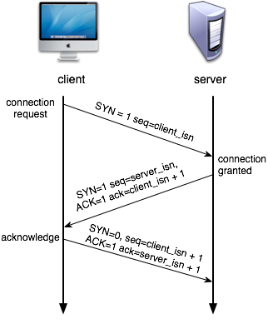
Three-way Handshake
Step 1: client sends TCP SYN segment to server
  specifies initial seq#
  holds no data
Step 2: server responds with SYNACK segment
  server allocates buffers
  specifies initial seq#
Step 3: Client replies with ACK
  May contain data
Notes:
ISN: Initial Sequence Number

Slide 20
Question
TCP specification requires each side of a connection to select an initial starting sequence number at random¹. Why?
¹Not exactly, but it's complicated. Let's pretend it is random.
Notes:
According to Stevens, page 232-3: RFC 793 states that the ISN should be viewed as a 32-bit counter that increments every 4 microseconds. ... 4.4 BSD starts at 1, then increments at 8 microseconds. It also is incremented by 64000 every time a connection is established.

Slide 21
Question
TCP specification requires each side of a connection to select an initial starting sequence number at random¹. Why?
  Avoid confusion with old connections
  Security benefit
    Predictable ISNs (like always starting at 0 or incrementing by 1) can be exploited for TCP session hijacking.
    Random ISNs make it harder for attackers to inject fake packets into a connection.
Notes:
According to Stevens, page 232-3: RFC 793 states that the ISN should be viewed as a 32-bit counter that increments every 4 microseconds. ...
4.4 BSD starts at 1, then increments at 8 microseconds. It also is incremented by 64000 every time a connection is established.

Slide 22
Question
Let’s say TCP does not exchange initial sequence numbers, and just use 0 as the starting point. What can happen?
  A client connects to a server → sends data (seq numbers 0,1,2,...).
  Connection closes, but some stray packets are still in the network (delayed).
  Client reconnects immediately to the same server (same IP/port tuple).
  New connection also starts at 0 → delayed old packets fall into the valid sequence number range and get accepted as new data.
  Result:
  Data corruption or wrong application behavior.
Notes:
According to Stevens, page 232-3: RFC 793 states that the ISN should be viewed as a 32-bit counter that increments every 4 microseconds. ... 4.4 BSD starts at 1, then increments at 8 microseconds. It also is incremented by 64000 every time a connection is established.

Slide 23
Example
If a host receives a TCP SYN segment to a closed port (no process is listening)
  The host replies with a TCP RST (Reset) segment.
  This tells the sender:
  “That port is closed — no connection will be established.”
  RST is TCP’s way of signaling an error condition.

Slide 24
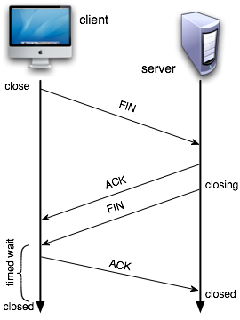
Closing a Connection
Step 1: Client sends TCP FIN segment to server
Step 2: Server receives FIN, responds with ACK
  Closes connection
  Sends FIN
Recall: Connection is bi-directional, needs to be shut down from each side

Slide 25
Closing a Connection
Step 3: client receives FIN, replies with ACK
  Client enters “timed wait”
  Will respond to FIN with ACK
  240 seconds (2 * max segment lifetime – MSL¹)
Step 4: server receives ACK, closes connection
  ¹MSL = longest time a TCP segment is allowed to exist in the network before being discarded.
  Typical MSL = 120 seconds.

Slide 26
Question
Why does client enter “timed wait” state before “closed,” even after receiving FIN from server?

Slide 27

Answer
Result:
If ACK from the client is lost, and the client does not wait?
  Client may open the same connection again (same pair of port#s)
  Receives FIN from earlier incarnation of connection
  Immediately initiate closing of the later incarnation
Any stray packets from the old connection have expired (1 × MSL).
Notes:
When TCP performs an active close, and sends the final ACK, that connection must stay in the TIME_WAIT state for twice the MSL (maximum segment lifetime, 2mins). This lets TCP resend the final ACK in case this ACK is lost (in which case the other end will timeout and retransmit its final FIN).
While the TCP connection is in the 2MSL wait, the socket pair defining that connection cannot be reused.
Any segments that arrived during the 2MSL wait is discarded

Slide 28
Outline
Connection-oriented Transport: TCP
Segment Structure
Connection Management
Reliable Data Transfer (RDT)

Slide 29
TCP RDT
TCP creates RDT service on top of IP’s unreliable service
  Pipelined segments
  Cumulative acks
  Retransmission timer
Retransmissions are triggered by:
  Timeout events
  Duplicate acks
Initially, we consider simplified TCP sender:
  Ignore duplicate acks
  Ignore flow control, congestion control
  assume RTT is estimated somehow
Notes:
1. Ignore duplicate ACKs
In real TCP, duplicate ACKs are used for fast retransmit and congestion detection.
For a first-step model, we ignore them so we don’t get distracted by advanced loss recovery.
We only care about:
👉 “Send data → wait for ACK → retransmit if timeout.”
2. Ignore flow control
Flow control (receiver’s advertised window) prevents overwhelming the receiver’s buffer.
If we ignore it, we can assume:
👉 “Receiver can always accept data.”
This removes receiver buffer limits from the picture, letting us focus only on reliability.
3. Ignore congestion control
Congestion control adapts to network capacity to avoid overloading routers.
But that requires algorithms like slow start, AIMD, etc.
In a simplified model, we pretend:
👉 “The network can carry whatever we send without congestion.”
Again, keeps the focus on basic send/ack/retransmit behavior.
4. Assume RTT is estimated somehow
In real TCP, RTT estimation uses exponential weighted averages (Jacobson/Karels algorithm).
But if we assume “RTT magically known,” then:
👉 We don’t have to model timing noise, just use the correct timeout value.
This simplifies retransmission logic — no need to build complex RTT estimators yet
Summary
We ignore duplicate ACKs, flow control, and congestion control, and assume RTT is known to simplify the model.
This way, we can first understand TCP’s core mechanism of reliable delivery (sequence numbers, ACKs, retransmissions).
Later, the more advanced features (fast retransmit, flow control, congestion control, RTT estimation) are layered back in.

Slide 30
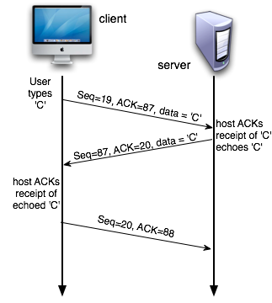
TCP Seq# and ACKs
Sequence numbers:
  byte stream “number” of first byte in segment’s data
ACKs:
  seq # of next byte expected from other side
  cumulative ACK
    acknowledges bytes up to the first missing byte in the stream
  piggybacked
    with data, if possible
Notes:
What is Piggybacking?
Piggybacking means combining an ACK (acknowledgment) with outgoing data in the same TCP segment, instead of sending a separate ACK packet.
This reduces the number of packets on the network → more efficient.
How it works
Normally, TCP must acknowledge received data.
You can send a standalone ACK (just header, no data).
If the receiver also has data to send back, it can attach that data to the ACK:
Header includes ACK flag + ACK number
Payload contains the application data
Result: 1 segment serves two purposes:
Acknowledge received bytes
Send new data
🔹 Example
Step 1: Client → Server: sends "Hello" (Seq = 1001, 5 bytes)
Step 2: Server receives "Hello" and wants to reply "Hi"
Instead of sending two packets:
Standalone ACK for "Hello"
Data "Hi"
Server piggybacks ACK with data "Hi" in one packet:
Seq = 5001 (server’s data) Ack = 1006 (next expected byte from client) Payload = "Hi"

Slide 31
TCP Sender Events
Data received from app:
  Create segment
  seq# is byte-stream number of first data byte in segment
  Send, if allowed by congestion & flow-control
  start timer if not already running (think of timer as for oldest unacked segment)
  expiration interval: TimeOutInterval
Timeout:
  retransmit segment that caused timeout
  restart timer
ACK received:
  If acknowledges previously unACKed segments
  update what is known to be ACKed
  start timer if there are outstanding segments

Slide 32
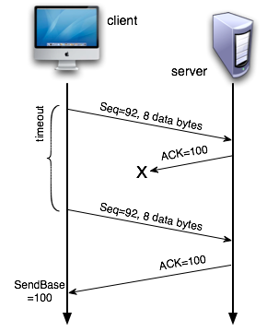
Retransmission Scenarios
Lost ACK
What does server do when it gets the retransmitted segment?
Discard it! Expected seq# is 100. Since 92 < 100 it knows this is duplicate data

Slide 33
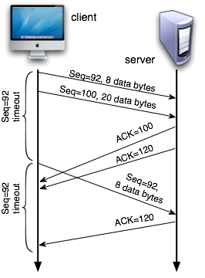
Retransmission Scenarios
Premature Timeout
Will client retransmit 2nd segment (Seq=100)?
No! ACK=120 arrives before the timeout
Notes:
In (b) Host A will retransmit second segment, why?
ACK is received before second timeout

Slide 34

Retransmission Scenarios
Cumulative ACK
Host hasn’t received ACK for first segment, so why doesn’t it retransmit?
ACK=120 is cumulative, which means everything up to byte 120 has been received (including 92)

Slide 35
ACK Generation
Event at receiver | Receiver Action
Arrival of in-order segment with expected seq#. All data up to seq# already ACKed | Delayed ACK. Wait up to 500ms for next segment. If no next segment, send ACK
Arrival of in-order segment with expected seq#. One other segment has ACK pending | Immediately send single cumulative ACK for both in-order segments
Arrival of out-of-order segment higher than expected seq#. Gap detected | Immediately send duplicate ACK, indicating seq# of next expected byte
Arrival of segment that partially or completely fills gap | Immediately send ACK, provided that segment starts at lower end of gap
Notes:
Delayed ACK: Host Requirements RFC states that delay must be less than 500ms. BSDI kernel had a 200ms timer going off, so delay could be 0 - 199ms.
1. In-Order Segment
A segment is in order if it arrives at the receiver in the same sequence as it was sent.
TCP guarantees that the application sees data in order.
Example:
Sender transmits 3 segments:
Seq 1000: "H" Seq 1001: "e" Seq 1002: "l"
If the receiver gets them in this exact order: 1000 → 1001 → 1002
This is in-order.
TCP can deliver immediately to the application.
Out-of-Order Segment
A segment is out of order if it arrives before some earlier segment(s).
TCP cannot deliver it to the application yet because the missing earlier bytes haven’t arrived.
The receiver buffers out-of-order segments until the missing ones come.
Example:
Sender transmits: 1000 → 1001 → 1002
Receiver gets: 1000 → 1002 → 1001
Segment 1002 is out-of-order (because 1001 hasn’t arrived yet).
TCP stores 1002 in a buffer and waits for 1001.
Examples:
1. Arrival of in-order segment with expected seq#. All data up to seq# already ACKed
Receiver Action: Delayed ACK. Wait up to 500ms for next segment. If no next segment, send ACK.
Example:
Expected seq#: 101
Received segment seq#: 101 (in-order)
ACKed up to: 100
Action: Receiver waits briefly to see if another segment arrives. If nothing comes in 500ms, it sends:
ACK 201 (assuming this segment had 100 bytes of data).
Scenario: This avoids sending too many ACKs when data is arriving quickly.
2. Arrival of in-order segment with expected seq#. One other segment has ACK pending
Receiver Action: Immediately send single cumulative ACK for both in-order segments.
Example:
Previously received in-order segment: seq# 101–200 (ACK not sent yet, pending)
Now received next in-order segment: seq# 201–300
Action: Receiver immediately sends ACK 301 (cumulative ACK covering both segments).
Scenario: Combines ACKs to reduce network traffic.
3. Arrival of out-of-order segment higher than expected seq#. Gap detected
Receiver Action: Immediately send duplicate ACK, indicating seq# of next expected byte.
Example:
Expected seq#: 101
Received out-of-order segment: seq# 201–300
Gap detected: missing bytes 101–200
Action: Receiver sends duplicate ACK 101 to tell sender: “I’m still waiting for seq# 101.”
Scenario: Helps the sender know a segment was lost or delayed.
4. Arrival of segment that partially or completely fills gap
Receiver Action: Immediately send ACK, provided that segment starts at lower end of gap.
Example 1 (partial gap fill):
Expected seq#: 101
Received segment: seq# 101–150
Previous out-of-order segment: seq# 201–300
Gap remaining: 151–200
Action: Receiver sends ACK 151 (next expected byte).
Example 2 (complete gap fill):
Now receive segment: seq# 151–200
Previously received: seq# 201–300
Action: Receiver sends ACK 301 (cumulative ACK for all in-order bytes).
Scenario: Allows TCP to quickly acknowledge recovered segments and continue in-order delivery.

Slide 36
Fast Retransmit
Time-out period often relatively long:
  Long delay before resending lost segment
Detect lost segments via duplicate ACKs
  Sender often sends many segments back-to-back
  If segment is lost, there will likely be many duplicate ACKs
If sender receives 3 duplicate ACKs, it supposes that segment after ACKed data was lost:
  Fast retransmit: resend segment before timer expires
Notes:
Tradeoffs in setting the timeout period (i.e. estimating the RTT)
Too long, have to wait, decreases throughput
Too short, premature timeout, wasted bandwidth in unnecessary retransmissions
How does sender detects lost packet?
Timeout
Duplicate ACK
When does receiver send a duplicate ACK?
When it receives a segment that is larger than the expected seq number
Detects a missing segment
ReACK the last byte received

Slide 37
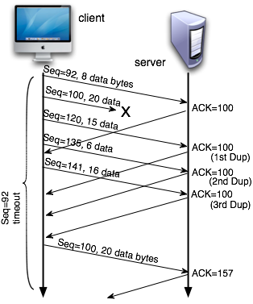
Scenario
Fast Retransmission
Sender doesn’t have to wait for a timeout to notice probable loss of seq=100 segment
Sort of a NACK

Slide 38
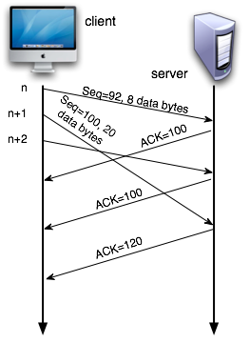
Why 3?
Why 3 duplicate ACKs? Why not do fast retransmit after the first duplicate ACK for a segment is received?
If n+1 and n+2 (or n+3) are just reordered, then waiting for 2 duplicate ACKs will not retrigger retransmission
  Voodoo constant
Notes:
When a receiver sends a duplicate ACK, two possible scenarios
The missing segment is lost
The missing segment gets reordered in transmission
If it is just reordering, then sender should not send a retransmission
Otherwise, sender should send a retransmission
Sender:
Guess that it is just reordering if only one or two duplicate ACKs
Guess that it is a lost segment if multiple subsequent segments were received
Why 3 duplicate ACKs trigger fast retransmit
Duplicate ACKs happen naturally in TCP
A duplicate ACK is sent whenever the receiver receives a segment out of order.
But sometimes, one duplicate ACK can happen for normal network reordering—it doesn’t always mean a segment is lost.
Using 3 as a threshold reduces false alarms
1 or 2 duplicate ACKs might just be caused by segments arriving slightly out of order.
Waiting for 3 duplicate ACKs makes TCP confident that a segment is actually lost rather than just delayed or reordered.
Mechanism:
Suppose expected seq# = 201.
Segment 201–300 is lost.
Segments 301–400, 401–500 arrive.
Receiver sends duplicate ACK 201 for each out-of-order segment (3 times).
Sender sees 3 duplicates → knows: “Segment 201–300 must be lost” → fast retransmit.

